Slide 1
TAS152
LECTURE 22
TOPIC 4
ARTIFICIAL INTELLIGENCE ETHICS
4. ETHICS SHOULD INFORM AI

Slide 2
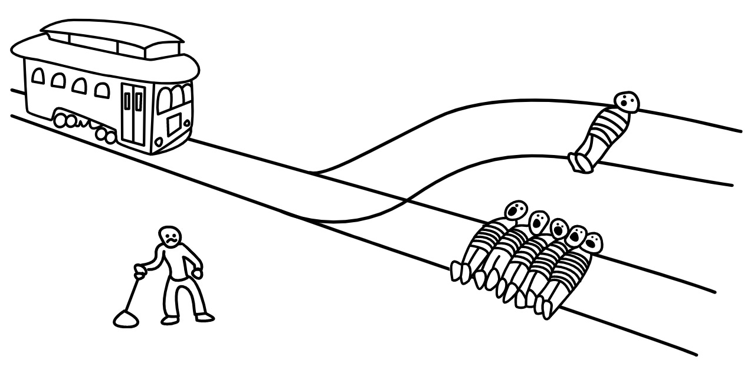
ETHICS SHOULD INFORM AI
We know by now that AI should be used in an ethical way.
We know a few rules of thumb i.e. "don't be biased" and "don't violate privacy"
What does this section focus on?
Closer look at different types of ethics
Different ethical systems
https://neal.fun/absurd-trolley-problems/

Slide 3


DEONTOLOGICAL VERSUS TELEOLOGICAL ETHICAL STANDARDS
Deontological ethical standards:
The intentions of the technology creator
The means by which the intentions are achieved.
Both the process and product are aligned with the desired ethical standards
Teleological ethical standards:
The desired ends and outcomes the technology creator wishes to achieve
Ethical implications of how the outcomes are achieved are NOT taken into account
Encourages risks during the development process as long as the desired outcome is achieved

Slide 4
DEONTOLOGICAL VERSUS TELEOLOGICAL ETHICAL STANDARDS
Which is better?
It depends on the scenario
Given the following scenario:
You have been shot on the battlefield.
You are busy bleeding out
You are taken to a nearby hospital.
There is only a single doctor, he explains that they don't have an anaesthetist
The doctor does have training on how to do basic anaesthetics.
In this scenario, we would rather apply teleological ethical standards.

Slide 5
DEONTOLOGICAL VERSUS TELEOLOGICAL ETHICAL STANDARDS
Given the following scenario:
Your appendix has ruptured
You are taken to a normal hospital in an average city
The surgeon explains that he has invented a new type of surgery
The new surgery doesn't use anaesthetics and normal surgical tools
The new surgery uses a robot hand guided by ChatGPT and you are temporarily paralysed from the waist down using a new type of electric medical device.
In this scenario, we would rather apply deontological ethical standards.

Slide 6
THE GOLDEN RULE OF ETHICS
Treat other people in the way that you would like them to treat you.
When it comes to AI, the data that is used for training comes from multiple different sources.
The AI is used in many different contexts.
The golden rule of ethics becomes difficult to apply i.e.
Treat other people in the way that you would like them to treat you.
Many different people will use the AI, how can we account for all of them?
Treat other people in the way that you would like them to treat you.
Who is "you"? The people who created the original data? The developers?

Slide 7
CULTURAL RELATIVISM VERSUS UNIVERSALISM
Cultural relativism:
Theory that morality is subjectively based on values practised within a particular culture.
Adopted by countries such as China.
Unwilling to adopt universal principles.
"You don't have to agree, but you will not be disrespectful"
Universalism:
Ideology that seeks the adherence of all nations to a mutually agreed set of ethical standards
Many difficulties in relation to the development and implementation of a universal set of ethical ideals
Challenge defining a single moral code that is acceptable to all nations.

Slide 8
DEVELOPING ETHICAL AS WELL AS TECHNICAL STANDARDS
A new legal framework based on a robust and universally accepted code of ethics will need to be developed and implemented.
Development of sector-specific guidelines, product and process standards
based on new or amended legal-regulatory frameworks and
monitored using AI technologies.
Invited to participate in drafting the new legal framework and its corresponding code of ethics
Government representatives
Industry spokespersons
Members of the private sector
Consumer groups
Academia

Slide 9
DEVELOPING ETHICAL AS WELL AS TECHNICAL STANDARDS
South Africa’s National Development Plan 2030
https://www.gov.za/issues/national-development-plan-2030
https://www.timeslive.co.za/politics/2024-05-08-ramaphosa-says-30-year-review-report-will-help-sa-achieve-ndp-vision/
https://www.dailymaverick.co.za/opinionista/2024-05-01-national-development-plan-the-greatest-achievement-so-far-of-democratic-south-africa/
https://www.farmersweekly.co.za/opinion/by-invitation/the-10-year-review-of-the-national-development-plan/

